Slide 1


Introduction to Machine Learning Workshop
Filipe Barata, Konstantin Hopf
Bamberg | 20. September 2017

Slide 2

Code Repository
https://github.com/pipo3000/kraken.git

Slide 3
Agenda
Part A (13:15 – 14:45)
Intro/basics/general input for machine learning (30 min, Filipe)
Walk-through R code (30 min, Konstantin)
Hands on: load data, feature extraction, classification (30 min)
Part B (15:15 – 16:45)
Short intro: feature extraction from trading data (5-10 min, Filipe)
Hands on: feature development (20 min)
Technical input: classification algorithms and parameter (30 min, Konstantin)
Hands on: tune model (20 min)
Wrap-up: comparison of model performances, feedback (10 min)

Slide 4
Machine Learning 101
What is Machine Learning?
Statistical Inference: Two Cultures
Objects and Measurements
Goal of Learning
Empirical Risk
Bias vs Variance
Evaluation
Literature

Slide 5
Big data is like teenage sex: everyone talks about it, nobody really knows how to do it, everyone thinks everyone else is doing it, so everyone claims they are doing it...
Dan Ariely

Slide 6

What is Machine Learning?
Roach, Jay, Mike Myers, and Elizabeth Hurley. "Austin powers: International man of mystery." United States: New Line Cinema (1997).

Slide 7
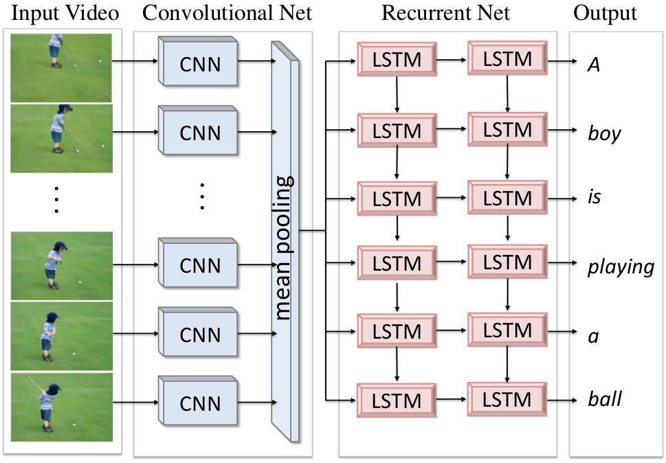
What is Machine Learning?
Venugopalan, Subhashini, et al. "Translating videos to natural language using deep recurrent neural networks." arXiv preprint arXiv:1412.4729 (2014).

Slide 8




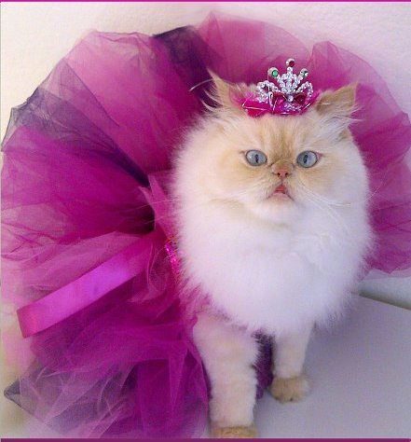

What is Machine Learning?
→
ƒ
LEARNING
ƒ( )
$$=$$
“CAT”
PREDICTION

Slide 9
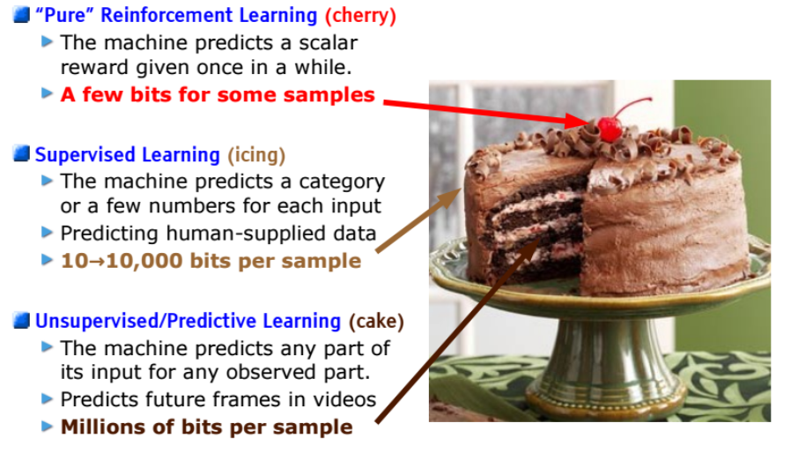
What is Machine Learning?
Yann, Lecun, “Deep Learning and the Future of AI." Talk, SoftBank Robotics Europe.

Slide 10
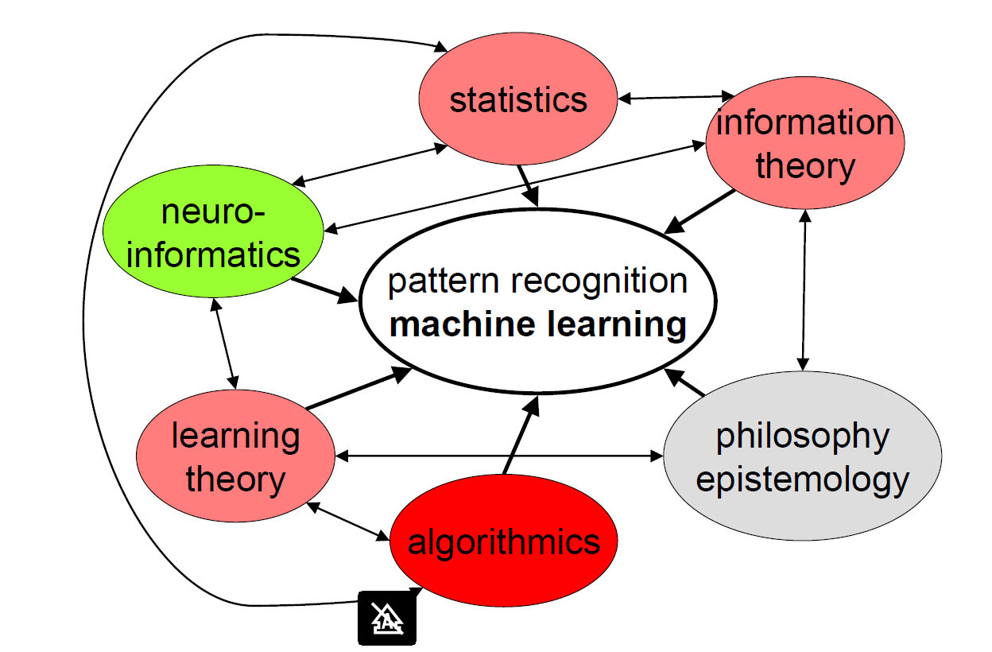
How Does “Machine Learning” Relate to Neighboring Scientific Areas
Buhmann, Joachim, “Machine Learning." ETH Zurich. 2016. Lecture

Slide 11
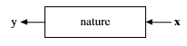
And There Shall Be Data…
Think of the data as being generated by a black box
There are two goals in analyzing the data:
Prediction
To be able to predict what the responses are going to be to future input variables
Information
To extract some information about how nature is associating the response variables to the input variables
Breiman, Leo. "Statistical modeling: The two cultures (with comments and a rejoinder by the author)." Statistical science 16.3 (2001): 199-231.

Slide 12
The Two Cultures
The Data Modeling Culture
The Algorithmic Modeling Culture
Assuming a stochastic data model
E.g. Data is generated by independet draws from Response variables = f(predictor variables, random noise, parameters)
Model Validation: Yes-no using goodness-of-fit tests and residual examination
Estimated Culture polulation: 98% of all statisticians
Inside box complex and unknown
Find function f(x) – an algorithm that operates on x to predict the response y
Model validation: Measured by predictive accuracy
Estimated culture population. 2% of statisticians, many in other fields
Breiman, Leo. "Statistical modeling: The two cultures (with comments and a rejoinder by the author)." Statistical science 16.3 (2001): 199-231.

Slide 13
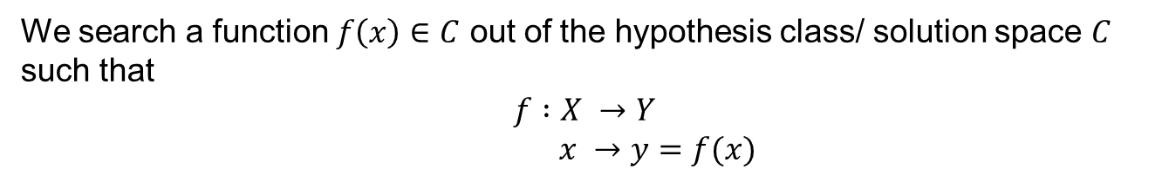
What is the learning goal?
We search a function $f\left(x\right)∈C$ out of the hypothesis class/ solution space $C$ such that
$$f :X →Y$$
$$x →y=f(x)$$
→
ƒ:
CAT

Slide 14
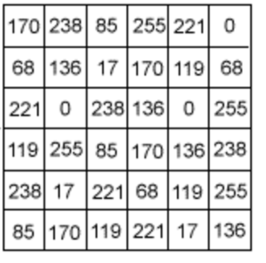
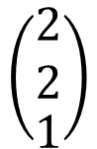
Objects and Measurements - Features
Measurements represent objects in a data space
e.g. cat pictures as objects and pixel intensity as measurements
$$\left(\begin{matrix}\begin{aligned}2 \\ 2\end{aligned} \\ 1\end{matrix}\right)$$
Typical:

Slide 15
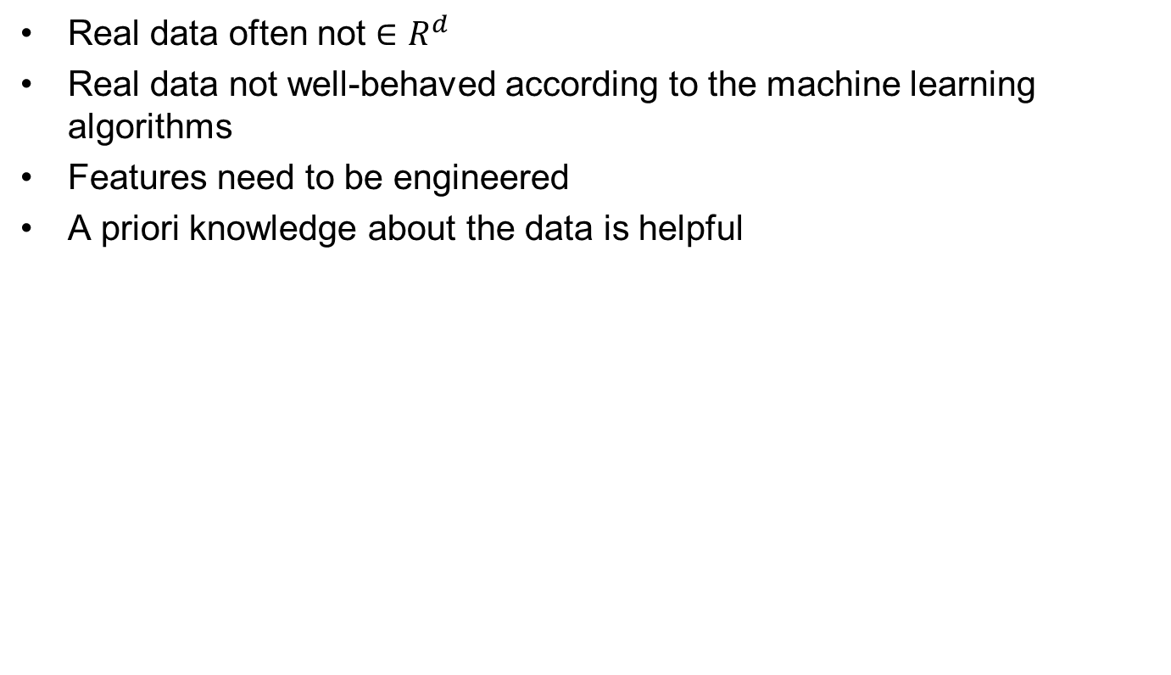
Objects and Measurements
Real data often not $∈R^{d}$
Real data not well-behaved according to the machine learning algorithms
Features need to be engineered
A priori knowledge about the data is helpful

Slide 16
Feature Space
Measurement space X: the mathematical space in which the data are represented, e.g., numerical, boolean or categorical features.
Features are derived quantities or indirect observations which often significantly compress the information content of measurements
Remark:
The selection of a specific feature space predetermines the metric to compare data; this choice is the first significant design decision in a machine learning system
Buhmann, Joachim, “Machine Learning." ETH Zurich. 2016. Lecture

Slide 17
The Goal of Learning
Estimation of Dependencies Based on Empirical Data
Typical learning problems:
Classification: Learning an indicator function
Regression: Learning a real valued function
Dimension reduction: Learning a linear or nonlinear
Data Compression: Learning a coding efficient representation
Vapnik, Vladimir Naumovich, and Samuel Kotz. Estimation of dependences based on empirical data. Vol. 40. New York: Springer-Verlag, 1982.

Slide 18
Classification: Learning an indicator function
Binary Classification

Slide 19
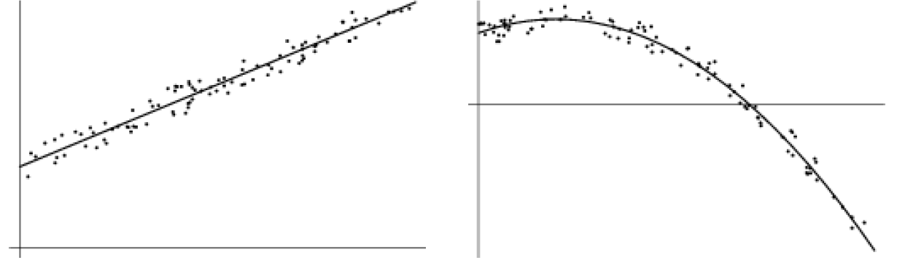
Regression: Learning a real valued function
Linear Regression
Non- Linear Regression

Slide 20
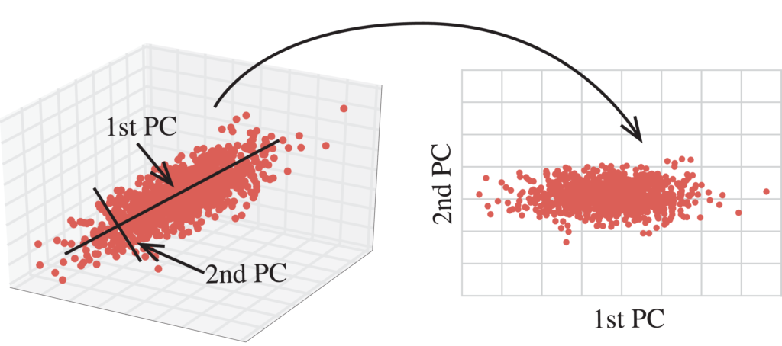
Dimension Reduction: Learning a linear or nonlinear projection
Principal Component Analysis

Slide 21
Data Compression: Learning a coding efficient representation
78 | 23
12 | 34
78 | 23
12 | 34

Slide 22
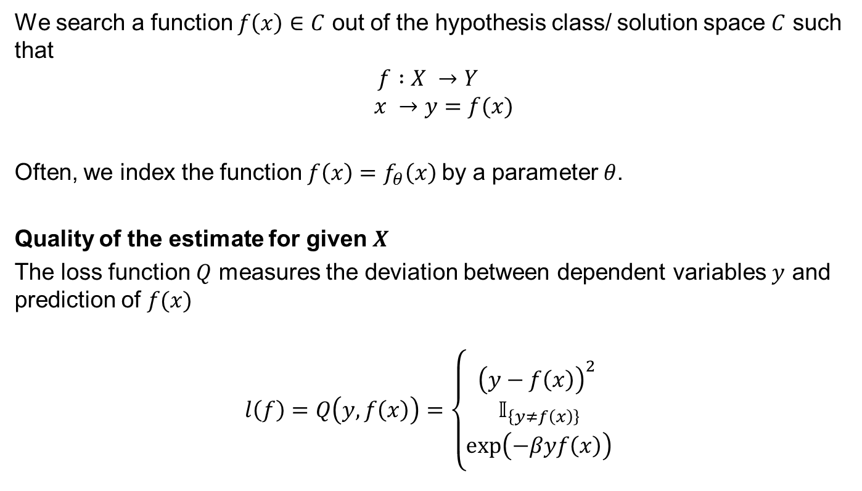
Estimating Dependencies Based on Empirical Data
We search a function $f\left(x\right)∈C$ out of the hypothesis class/ solution space $C$ such that
$$f :X →Y$$
$$x →y=f(x)$$
Often, we index the function $f\left(x\right)=f_{θ}\left(x\right)$by a parameter $θ$.
Quality of the estimate for given $X$
The loss function $Q$ measures the deviation between dependent variables $y$ and prediction of $f(x)$
$$l\left(f\right)=Q\left(y,f\left(x\right)\right)=\left\{\begin{aligned}{\left(y−f\left(x\right)\right)}^{2} \\ 𝕀_{\left\{y≠f\left(x\right)\right\}} \\ \exp\left(−βyf\left(x\right)\right)\end{aligned}\right.$$
Quadratic loss (regression)
0-1 loss (classification)
Exponential loss (classification)
Buhmann, Joachim, “Machine Learning." ETH Zurich. 2016. Lecture

Slide 23
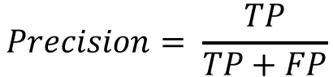
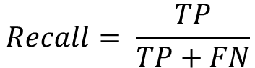
Classifier evaluation
Confusion Matrices
Accuracy: “Correct decisions”
 | True positive | True negative
Predicted positive | TP | FP
Predicted negative | FN | TN
$$Accuracy= \frac{TP+TN}{TP+FN+FP+TN}$$
Precision: “Actual positives among positively tested”
 | True positive | True negative
Predicted positive | TP | FP
Predicted negative | FN | TN
$$Precision= \frac{TP}{TP+FP}$$
Recall (Sensitivity): “Ability to detect positives”
 | True positive | True negative
Predicted positive | TP | FP
Predicted negative | FN | TN
$$Recall= \frac{TP}{TP+FN}$$
Specificity: “Ability to detect negatives” =$TN/(FP+TN)$

Slide 24
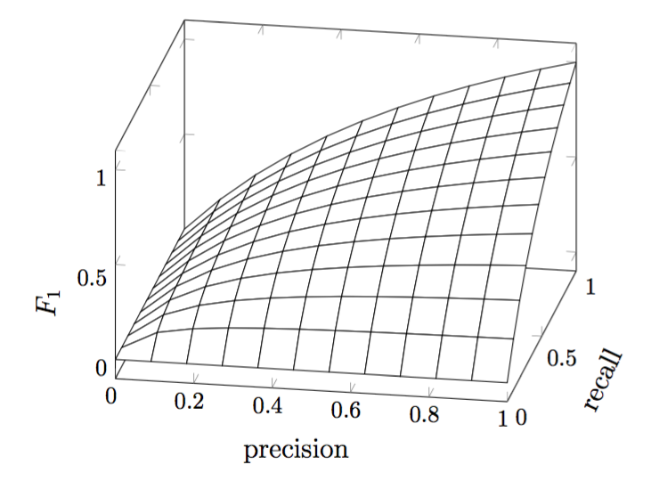
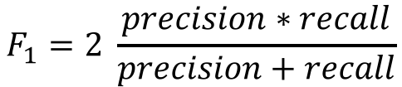
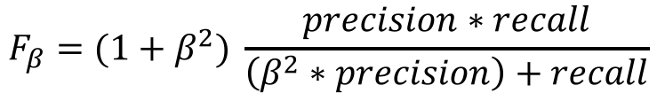
Trade-off between precision and recall
In classifier tuning, precision and recall needs to be optimized
Therefore, the harmonic mean between both measures F₁ is considered
F₁ has its best value at 1 and its worst at 0
To weight either precision or recall, the parameter β can be introduced:
$$F_{1}=2 \frac{precision∗recall}{precision+recall}$$
$$F_{β}=(1+β^{2}) \frac{precision∗recall}{\left(β^{2}∗precision\right)+recall}$$

Slide 25
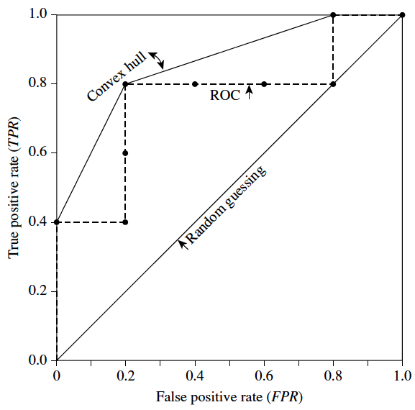
Recap: Receiver Operating Characteristics (ROC)
A further tool for classifier evaluation are ROC curves
ROC shows the trade-off between the
true positive rate (TPR=TP/P) and
false positive rate (FPR=FP/N).
The area under ROC curve (AUC) is a common metric for classifier evaluation.
Classification: ideally AUC > 0.5
Random guessing: AUC = 0.5

Slide 26
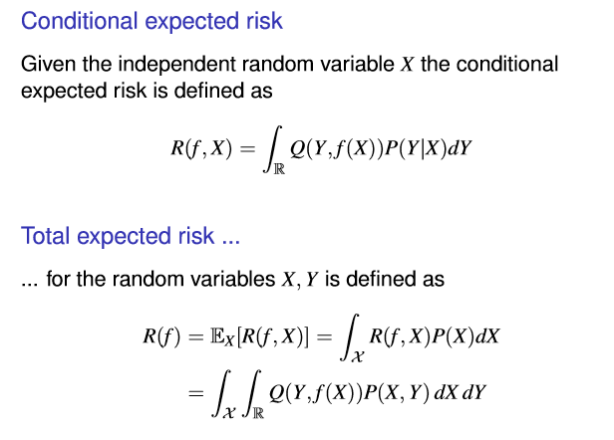
Expected risk
Buhmann, Joachim, “Machine Learning." ETH Zurich. 2016. Lecture

Slide 27
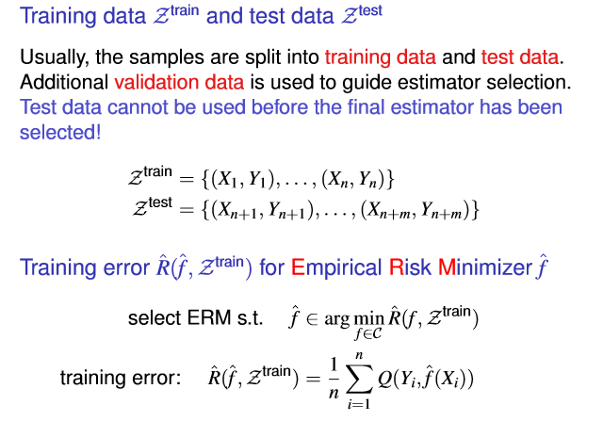
Empirical Risk
Buhmann, Joachim, “Machine Learning." ETH Zurich. 2016. Lecture

Slide 28
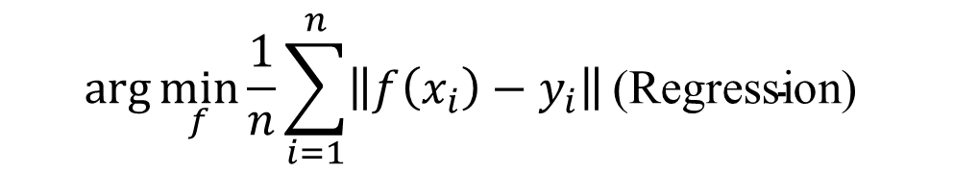
Remarks
Learning requires to infer a functional or statistical relationship between variables when we only know noisy samples. Approximation and interpolation in function estimation are such procedures.
The problem without additional assumptions is mathematically ill-deﬁned since many different functions might be compatible with noisy observations.
We, therefore, require that our inference has to “work” on future data. Mathematically, the expected quality of inference should be high and not necessarily the empirically observed quality.
$$\arg{\min_{f}{\frac{1}{n}}{\sum_{i=1}^{n}{\left\|f\left(x_{i}\right)−y_{i}\right\|}}{\text{(}\text{Regression}\text{) }}}$$
Existence
Convergence
Buhmann, Joachim, “Machine Learning." ETH Zurich. 2016. Lecture

Slide 29
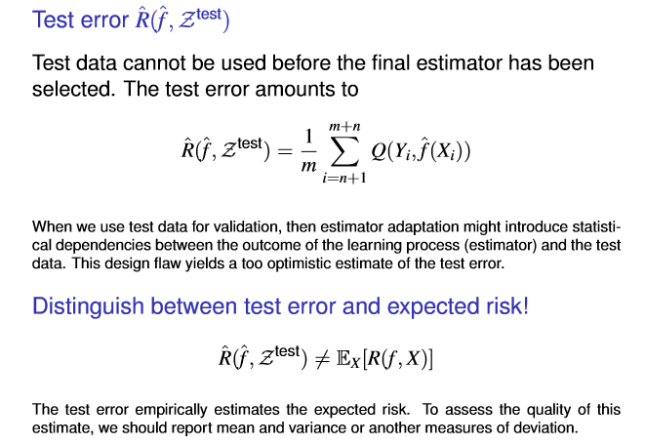
Empirical Test Error and Expected Risk
Buhmann, Joachim, “Machine Learning." ETH Zurich. 2016. Lecture

Slide 30
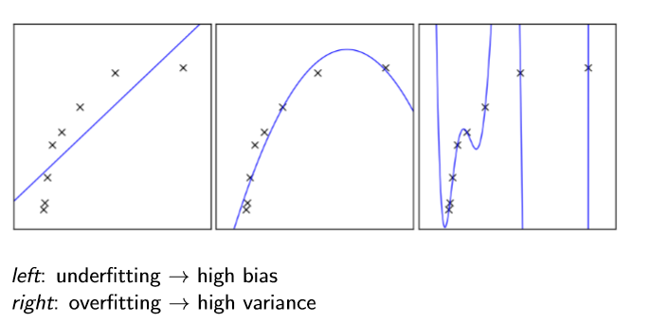
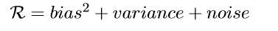
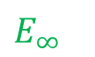
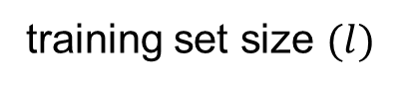

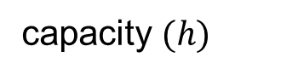

Data Dimensions
ng Dependencies Based on Empirical Data
Bias vs. Variance
% error
% error
test
$E_{∞}$
test
training
$$h=h^{∗}$$
$l_{c}$
capacity $(h)$
training set size $(l)$
Buhmann, Joachim, “Machine Learning." ETH Zurich. 2016. Lecture

Slide 31
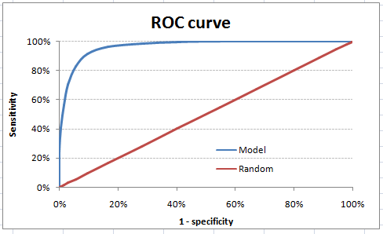

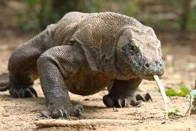
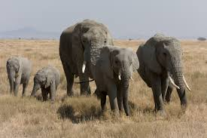
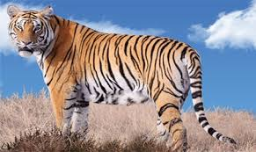
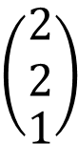
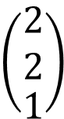
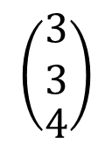
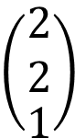
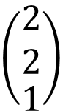
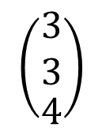
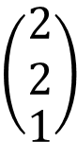
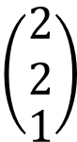
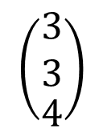
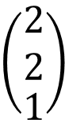
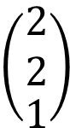
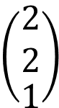
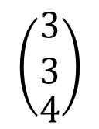
Learning Pipeline
Features Extraction
Training
Evaluation
«cat»
$$\left(\begin{matrix}\begin{aligned}2 \\ 2\end{aligned} \\ 1\end{matrix}\right)$$
$$\left(\begin{matrix}\begin{aligned}2 \\ 2\end{aligned} \\ 1\end{matrix}\right)$$
$$\left(\begin{matrix}\begin{aligned}2 \\ 2\end{aligned} \\ 1\end{matrix}\right)$$
$$\left(\begin{matrix}\begin{aligned}2 \\ 2\end{aligned} \\ 1\end{matrix}\right)$$
$$\left(\begin{matrix}\begin{aligned}2 \\ 2\end{aligned} \\ 1\end{matrix}\right)$$
$$\left(\begin{matrix}\begin{aligned}2 \\ 2\end{aligned} \\ 1\end{matrix}\right)$$
$$\left(\begin{matrix}\begin{aligned}2 \\ 2\end{aligned} \\ 1\end{matrix}\right)$$
$$\left(\begin{matrix}\begin{aligned}2 \\ 2\end{aligned} \\ 1\end{matrix}\right)$$
$$\left(\begin{matrix}\begin{aligned}2 \\ 2\end{aligned} \\ 1\end{matrix}\right)$$
«no cat»
$$\left(\begin{matrix}\begin{aligned}3 \\ 3\end{aligned} \\ 4\end{matrix}\right)$$
$$\left(\begin{matrix}\begin{aligned}3 \\ 3\end{aligned} \\ 4\end{matrix}\right)$$
$$\left(\begin{matrix}\begin{aligned}3 \\ 3\end{aligned} \\ 4\end{matrix}\right)$$
$$\left(\begin{matrix}\begin{aligned}3 \\ 3\end{aligned} \\ 4\end{matrix}\right)$$
$$\left(\begin{matrix}\begin{aligned}3 \\ 3\end{aligned} \\ 4\end{matrix}\right)$$
$$\left(\begin{matrix}\begin{aligned}3 \\ 3\end{aligned} \\ 4\end{matrix}\right)$$
$$\left(\begin{matrix}\begin{aligned}3 \\ 3\end{aligned} \\ 4\end{matrix}\right)$$
$$\left(\begin{matrix}\begin{aligned}3 \\ 3\end{aligned} \\ 4\end{matrix}\right)$$
$$\left(\begin{matrix}\begin{aligned}3 \\ 3\end{aligned} \\ 4\end{matrix}\right)$$
$$\left(\begin{matrix}\begin{aligned}3 \\ 3\end{aligned} \\ 4\end{matrix}\right)$$
$$\left(\begin{matrix}\begin{aligned}3 \\ 3\end{aligned} \\ 4\end{matrix}\right)$$
$$\left(\begin{matrix}\begin{aligned}3 \\ 3\end{aligned} \\ 4\end{matrix}\right)$$
Sensitivity | Specificity | Accuracy
92 % | 83 % | 88 %
$$\left(\begin{matrix}\begin{aligned}3 \\ 3\end{aligned} \\ 4\end{matrix}\right)$$
$$\left(\begin{matrix}\begin{aligned}3 \\ 3\end{aligned} \\ 4\end{matrix}\right)$$
$$\left(\begin{matrix}\begin{aligned}3 \\ 3\end{aligned} \\ 4\end{matrix}\right)$$
Data
Features
Model
Results

Slide 32
Evaluation
Evaluation Dependencies Based on Empirical Data
BIG
Train
Validation
Test
Randomly split your dataset into a training set, a validation set and a test set.
Due to the large size of the validation and the test set, the estimation of the generalization error is accurate enough to be used for model selection and model assessment
DATA
Train & Validation & Test
SMALL
May not be able to aﬀord sacriﬁcing a large fraction of the available data for validation and testing.
Instead, one can use cross-validation or bootstrapping.
Buhmann, Joachim, “Machine Learning." ETH Zurich. 2016. Lecture

Slide 33
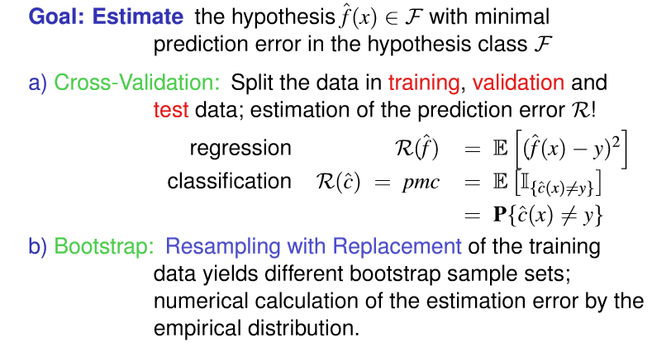
Numerical Estimation Techniques
Buhmann, Joachim, “Machine Learning." ETH Zurich. 2016. Lecture

Slide 34
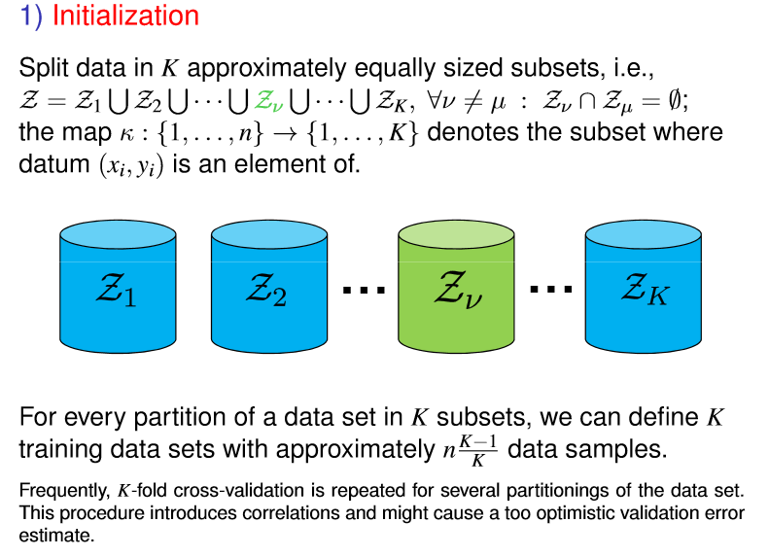

$K$-Fold Cross-Validation
Buhmann, Joachim, “Machine Learning." ETH Zurich. 2016. Lecture

Slide 35
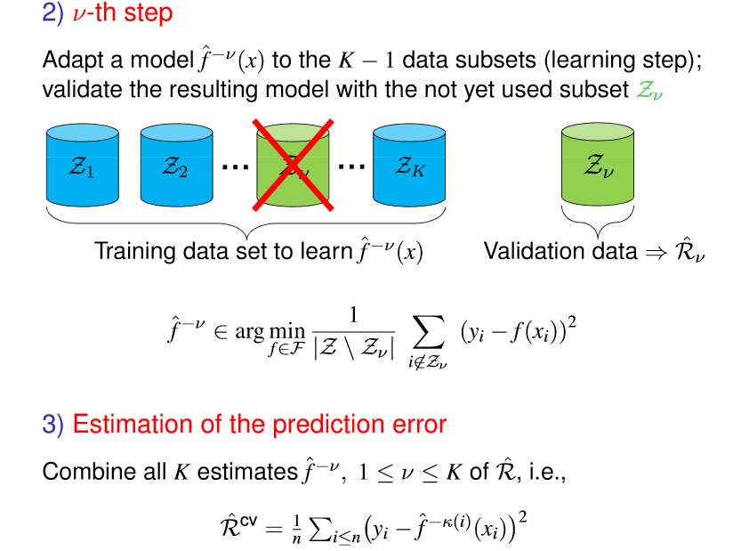
Buhmann, Joachim, “Machine Learning." ETH Zurich. 2016. Lecture

Slide 36
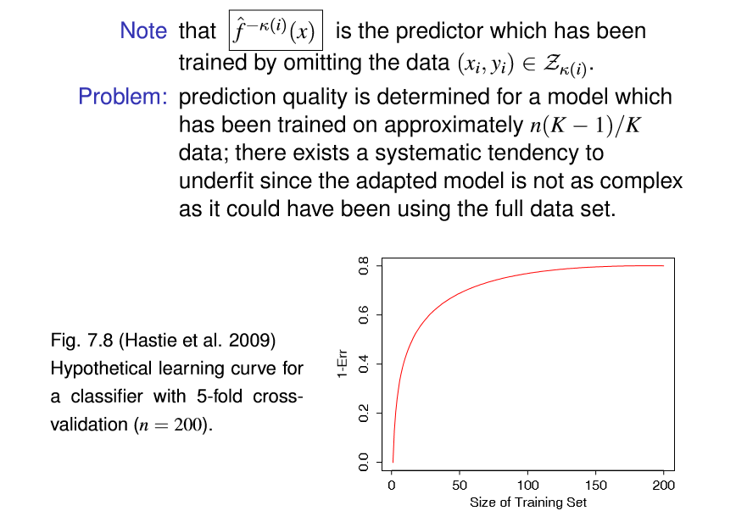
$K$-Fold Cross-Validation
Buhmann, Joachim, “Machine Learning." ETH Zurich. 2016. Lecture

Slide 37
Literature
Bishop, Christopher M. Pattern recognition and machine learning. springer, 2006.
Duda, Richard O., Peter E. Hart, and David G. Stork. Pattern classification. John Wiley & Sons, 2012.
Friedman, Jerome, Trevor Hastie, and Robert Tibshirani. The elements of statistical learning. Vol. 1. New York: Springer series in statistics, 2001.

Slide 38
Introduction to Machine Learning Workshop Data Set & Feature Engineering
Filipe Barata, Konstantin Hopf
Bamberg | 20. September 2017

Slide 39

Ethereum Challenge

Slide 40
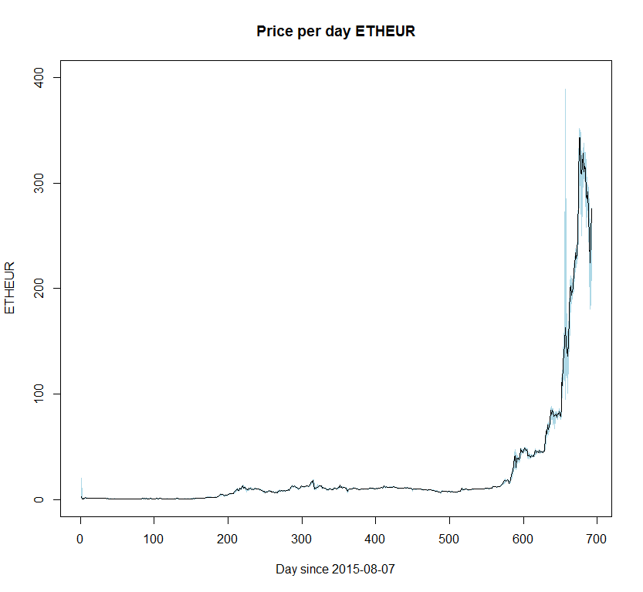
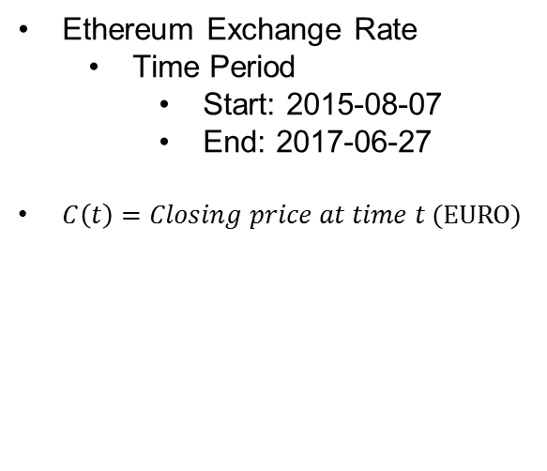
Data Set
Ethereum Exchange Rate
Time Period
Start: 2015-08-07
End: 2017-06-27
$C\left(t\right)=Closing price at time t (EURO)$

Slide 41

Predicting the Direction of Stock Market
Three classes: Lower, Equal, Higher
Labeling :
Formula: $Label= \left\{\begin{aligned}Higher if C\left(t\right)−C\left(t−1\right)> ε \\ Lower if C\left(t\right)− C\left(t−1\right)<−ε \\ Equal if \left|C\left(t\right)−C\left(t−1\right)\right|< ε \end{aligned}\right.$
$C\left(t\right)=Closing price at time t$
$ε=\frac{1}{8} of the standard deviation of C(t)$ $≈0.56 Euro$

Slide 42

Relative Strength Index
Formula: $RSI=100 −\frac{100}{1+RS}$
$RS=$ $\frac{Average Gain Over past 14 days}{Average Loss Over past 14 days}$
RSI is a popular momentum indicator which determines whether the stock is overbought or oversold. A stock is said to be overbought when the demand unjustiﬁably pushes the price upwards. This condition is generally interpreted as a sign that the stock is overvalued and the price is likely to go down. A stock is said to be oversold when the price goes down sharply to a level below its true value. This is a result caused due to panic selling. RSI ranges from 0 to 100 and generally, when RSI is above 70, it may indicate that the stock is overbought and when RSI is below 30, it may indicate the stock is oversold.

Slide 43

Stochastic Oscillator
$Formula: \%K=100 ∗\frac{(C −L14)}{(H14 −L14)}$
$C=Current Closing Price$
$L14=Lowest Low over the past 14 days$
$H14=Highest High over the past 14 days$
Stochastic Oscillator follows the speed or the momentum of the price. As a rule, momentum changes before the price changes. It measures the level of the closing price relative to low-high range over a period of time.

Slide 44
Williams %R
$Formula: \%R=\frac{(H14 −C)}{(H14 −L14)} ∗−100$
$C=Current Closing Price$
$L14=Lowest Low over the past 14 days$
$H14=Highest High over the past 14 days$
Williams %R ranges from -100 to 0. When its value is above -20, it indicates a sell signal and when its value is below -80, it indicates a buy signal.

Slide 45

Moving Average Convergence Divergence
$Formula : MACD=EMA_{12}\left(C\right)−EMA_{26}(C)$
$SignalLine=EMA_{9}(MACD)$
$MACD=Moving Average Convergence Divergence$
$C=Closing Price Series$
$EMA_{n}=n day Exponential Moving Average$
EMA stands for Exponential Moving Average. When the MACD goes below the SingalLine, it indicates a sell signal. When it goes above the SignalLine, it indicates a buy signal.

Slide 46

Price Rate of Change
$Formula: PROC(t)=\frac{(C\left(t\right)−C\left(t−n\right))}{C(t−n)}$
$PROC\left(t\right)=Price Rate of Change at time t$
$C\left(t\right)=Closing price at time t$
$H14=Highest High over the past 14 days$
It measures the most recent change in price with respect to the price in n days ago.

Slide 47

On Balance Volume
Formula: $OBV\left(t\right)= \left\{\begin{aligned}OBV\left(t−1\right)+Vol\left(t\right) if C\left(t\right)>C(t−1) \\ OBV\left(t−1\right)−Vol\left(t\right) if C(t)<C(t−1) \\ OBV\left(t−1\right) if C\left(t\right)=C(t−1)\end{aligned}\right.$
$OBV\left(t\right)=On Balance Volume at time t$
$Vol\left(t\right)=Trading Volume at time t$
$C\left(t\right)=Closing price at time t$
This technical indicator is used to ﬁnd buying and selling trends of a stock.

Slide 48
Literature
Khaidem, Luckyson, Snehanshu Saha, and Sudeepa Roy Dey. "Predicting the direction of stock market prices using random forest." arXiv preprint arXiv:1605.00003 (2016).

Slide 49
Introduction to Machine Learning Workshop Overview to classification algorithms
Filipe Barata, Konstantin Hopf
Bamberg | 20. September 2017

Slide 50
Classification algorithms - Overview
Decision trees
k Nearest Neighbors
Learns a decision tree from the data
Important parameters: depends on the tree learning algorithm
Infers the class membership from its k nearest neighbors
Important parameters: k, distance metric
Random Forest
Support Vector Machine
Evaluates a number of uncorrelated decision trees for their suitability
Important parameters: number of trees, parameters for decision tree generation
Searches for a maximum margin around the decision boundary (even in higher-dimensional space)
Important parameters: C (cost of misclassification), kernel function with their parameters, …

Slide 51

Decision trees
A typical decision tree learner generates one decision tree from the data
Multiple algorithms exist
Typical approach:
Sort features by the association to the dependent variable
For each feature that was not processed: implement a binary split to divide the data into the classes

Slide 52
R syntax for decision tree algorithm (package “party”)
model_DT <- ctree( formula, data,
controls=ctree_control(testtype=“Univariate”, ...),
... )
This implementation calculates the association between features and the dependent variable using statistical tests
Example parameters passed with the function ctree_control:
testtype: defines the statistical test used
mincriterion: the 1-p-value level as decision rule
maxdepth: maximum depth of the tree (standard: unlimited)
minsplit, minbucket, mtry: further specify tree generation

Slide 53


k Nearest Neighbor (kNN)
Learning rule: assign the most frequent class of the nearest k examples
kNN is a “lazy-learner”, since the learning is postponed to the prediction phase. There is no explicit training of kNN.
There is no general rule for the “best k”, it depends on the problem and the data
The distance metric can be varied (typical: Euclidean distance)
Source: P. Rai

Slide 54
R syntax for kNN algorithm (package “class”)
prediction_kNN <- knn( train, test, cl,
k = 1, l = 0, prob = FALSE, use.all = TRUE)
In this implementation, only the Euclidean distance can be used
Parameters:
train, test: feature sets for training and test cases
cl: the true class labels for training cases
l: minimum vote for definite decision (must be less than k-1)
prob: returns probabilities as relative frequencies of the class in k nearest neighbors
Other implementations are provided by packages “caret” or “FNN”

Slide 55


Support Vector Machine (SVM)
The aim of SVM is to find a hyperplane (line in a two dimensional case) that “best” separates the two classes from each other (optimization problem)
The hyperplane is defined with support vectors
When the data is no linearly separable, a kernel function is used to map the data into a higher dimensional space, where the data can be linearly separated.
Linearly separable case
Not linearly separable case
Notes:
immer konvexes problem

Slide 56
R syntax for SVM (package “e1071”) and parameters
model_SVM <- svm( formula, data,
cost,
kernel, degree, coef0, gamma,
scale = TRUE, ...)
Multiple parameters are available to “tune” the SVM:
cost: cost of misclassification → influences the size of the margin around the hyperplane
kernel: the kernel function (either “linear”, “polynomial”, “radial basis” a.k.a. Gaussian, “sigmoid”)
degree, gamma, coef0: parameters to the kernels
Meaningful parameter values for grid-search:
Parameter | Possible range | Meaningful values
kernel | linear, radial basis, polynomial, sigmoid
eps | Decimal | 0.1
cost | Decimal | 2E^2(-5, …, 10)
deg | Decimal | 2, 3, 4, 5
coef | Decimal | 0, 1, 5, 10, 100

Slide 57

Random Forest
Divide and conquer approach:
Is an ensemble learner; that means multiple weak learners are combined to one strong learner
Approach:
The random forest algorithm generates multiple low correlated decision trees (by subsampling the training set) that are evaluated with performance measures → weights for each tree are calculated
For classification, the prediction of each decision tree is weighted for the final prediction of the “forest”
Notes:
nicht immer lösbares Problem

Slide 58
R syntax (package “randomForest”) and parameters
model_RF <- randomForest( formula, data,
ntree,
mtry, ...)
Additionally to parameters of the used decision tree algorithm, the following parameters can be used to “tune” the Random Forest:
ntree: number of trees to grow (not too small, initially 500)
mtry: number of variables randomly sampled as candidates at each split
nodesize: Minimum size of terminal nodes
samsize, strata: controls the subsample generation

Slide 59
Do we Need Hundreds of Classifiers to Solve Real World Classification Problems?
Abstract: “We evaluate 179 classifiers arising from 17 families […] including all the relevant classifiers available today. We use 121 data sets, […] in order to achieve significant conclusions about the classifier behavior, not dependent on the data set collection. The classifiers most likely to be the bests are the random forest (RF) versions, the best of which (implemented in R and accessed via caret) achieves 94.1% of the maximum accuracy overcoming 90% in the 84.3% of the data sets. However, the difference is not statistically significant with the second best, the SVM with Gaussian kernel implemented in C using LibSVM, which achieves 92.3% of the maximum accuracy. […] The random forest is clearly the best family of classifiers (3 out of 5 bests classifiers are RF), followed by SVM (4 classifiers in the top-10), neural networks and boosting ensembles (5 and 3 members in the top-20, respectively).”
Fernández-Delgado, M., Cernadas, E., Barro, S., & Amorim, D. (2014). Do we need hundreds of classifiers to solve real world classification problems. J. Mach. Learn. Res, 15(1), 3133-3181.

Slide 60
Other machine learning algorithms
Statistical approaches:
Discriminant analysis
Bayesian learners
Partial least squares / principal component regression
Multivariate adaptive regression splines
Artificial neural networks
Ensemble learners (Bagging, Boosting)
Hidden Markov Models
Inductive logic programming
Genetic algorithms
Reinforcement learning
Unsupervised learning
…

Slide 61
Beyond classifier tuning – some advices:
Please keep in mind: data matters! (“bullshit in – bullshit out”)
Is that what you predict really that what you are interested in? ➔ Think about the definition of the dependent variable!
Are you interested in the best x% → use the classifier probabilities
Are you interested in a minority class? → use class weights or consider over/undersampling
Scale all features to the same dimension (some implementations provide parameters to do that)
Consider feature selection when you have > 20 features to overcome the “curse of dimensionality”

Slide 62

Logistic regression with feature selection achieved Accuracy results that are nearly as high as those from SVM or Random Forest without feature selection
Evaluation method
Benchmark (no feature selection)
Hopf, Weigert (2017)
Change in Accuracy (compared to no feature selection)
Change in Accuracy (compared to no feature selection)
We benchmarked 43 feature selection methods on 22 classification problems from energy retail with ca. 250 features (smart meter household classification)

